Slide 1
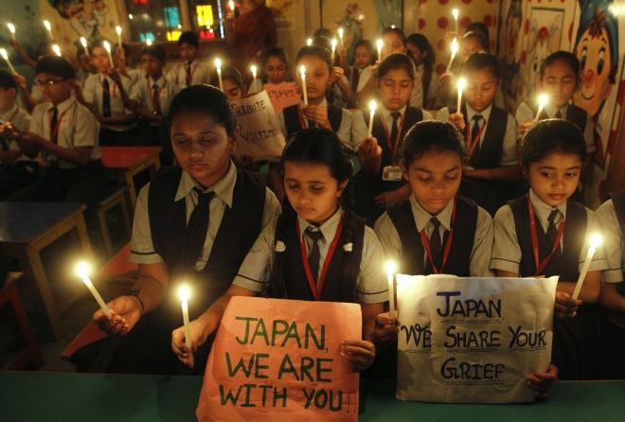
3.11 Project for High School Students
Developed with a grant from the US-Japan Foundation
Project Manager: Norman T. Masuda
Project Associates and Advisors:
Professor Indra Levy – Stanford Univ.
Koichi Sano Sensei – Abraham Lincoln HS,
San Francisco, CA
Joanne Akamine Sensei - ‘Iolani School,
Honolulu, HI

Slide 2
3.11 Project for High School Students
Plan: Create high school-level materials based on the 3.11 focused documents from IUC-Yokohama
Focus: Great East Japan Earthquake
Medium: Japanese Manga (Comic Strip)
Theme: A Japanese Family Experiencing the 3-11 Earthquake
Goal: . Align high school materials with National and Common Core Standards

Slide 3
3.11 Project for High School Students
Rationale:
1. Many changes have occurred since 3-11 that will require students to update materials to complete their assignments
2. High school-level materials will be aligned to National and Common Core Standards
3. Follow-up projects will require that students collaborate and communicate in Japanese and will combine disciplines such as science, social studies, math, and technology
4. Students will gain a better understanding of their role in the world of the future by studying global disasters (with focus on 3-11)

Slide 4
3.11 Project for High School Students
Long-term objectives Manga Project:
Students will
A. understand what 3-11 is based on Manga and be able to explain this to others (Standard One: Communication)
B. compare 3-11 to events closer to home and compare how people reacted to these events
(Standard Two: Culture; Standard Three: Comparisons; Standard Four: Connections)
C. be able to present information about 3-11 and domestic events to their peers and other audiences (Standard One: Communication; Standard Two: Culture)
D. plan for future disasters with a global perspective and become lifelong learners (Standard Five: Communities, Common Core)

Slide 5
3.11 Project for High School Students
Selection and preparation of materials:
A. Topics of interest to and valuable as information to American high school students
B. Materials based on levels of difficulty to students in advanced-level Japanese courses in secondary schools.
C. Activities and projects that will further student’s understanding of 3-11 and will help them to recognize the implications of such events on a global basis, with particular emphasis on events in the United States, such as Katrina, etc.

Slide 6
3.11 Project for High School Students
3-11 Manga Project objectives:
Students will examine and identify a Japanese Manga and point out its parts. (Interpretive)
Students will recognize as Onomatopoeia those elements that appear more than once in the Manga and be able to identify/explain their use. (Interpretive)
Students

Slide 7
3.11 Project for High School Students
3-11 Manga Project objectives: (2)
Students will discuss with peers the story in the Manga and give simple summaries based on the vocabulary found in the Manga. (Interpersonal)
Students take roles from the Manga: Narrator, Characters, and Sound Effects to read aloud with accurate pronunciation and understanding of meaning. (Presentational)

Slide 8
3.11 Project for High School Students
3-11 Manga Project objectives: (3)
Students will act out the events in the Manga, taking the various roles and make a video of their presentation. (Presentational)
Students will discuss and report activities that they participated in to aid in the 3-11 relief. (Interpersonal, Presentational)

Slide 9
3.11 Project for High School Students
Materials:
1a. Original Manga
1b. Text of the Manga
1c. Vocabulary List for the Manga
2. Introduction to the Japanese Manga
3. Introduction to Japanese Onomatopoeia
4. World-wide earthquake disaster chart exercise
School Follow-up project description
Can Do Statements (Student worksheet)
Evaluation of the Materials (Student small group activity)

Slide 10
3.11 Project for High School Students
Can Do Statements
A. Students will be able to perform specific linguistic tasks based on the materials studied
B. Students will be able to explain the significance and importance of these events to both Japan and America

Slide 11
3.11 Project for High School Students
How to personalize 3-11 for American high school students in future projects:
A. Students will search for and obtain materials concerning events in the United States as reported in the Japanese press or televised news media to use as a comparison
B. Students will compare and contrast 3.11 with events in the United States (ACTFL Standards 3)

Slide 12
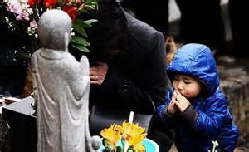
3.11 Project for High School Students
Toward Better World Understanding and Student Awareness of Interconnectedness of All People

Slide 13
3.11 Project for High School Students
おわり

